Slide 1
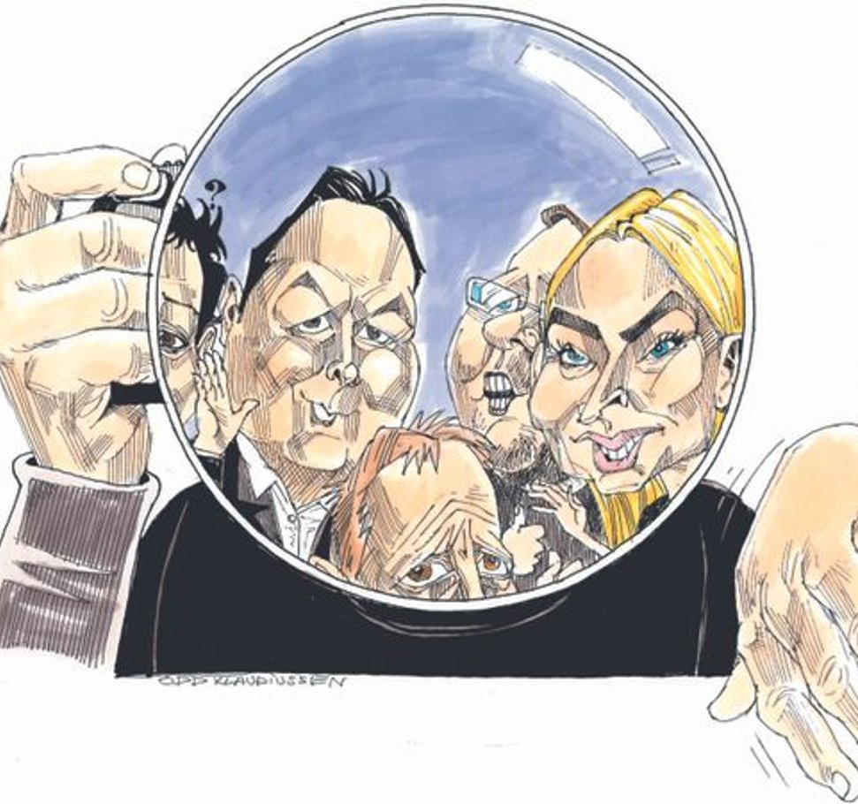
Investigative journalism in a small newsroom

Slide 2
Litterally?
«Han har selv tatt spaden fatt og omtalt forholdet på trykk. Slik sett har journalisten faktisk skaffet til veie bevis.»
Jens Johan Hjort til Journalisten i 2008

Slide 3
Our newsroom
Roughly 24 people work in the newsroom.
Online coverage every day from 06.00 til 23.00 – paper edition 6 days a week.
8800 subscribers
Strong competition from Nordlys and NRK
Close cooperation with PMNN, E24 og VG. Our local news gets national coverage.

Slide 4
How we work
Internal and external courses
Cooperation with SUJO
Hiring a developer
Computer supported journalism
We expect our journalists to be able to cover any story. But they get assigned special fields.

Slide 6
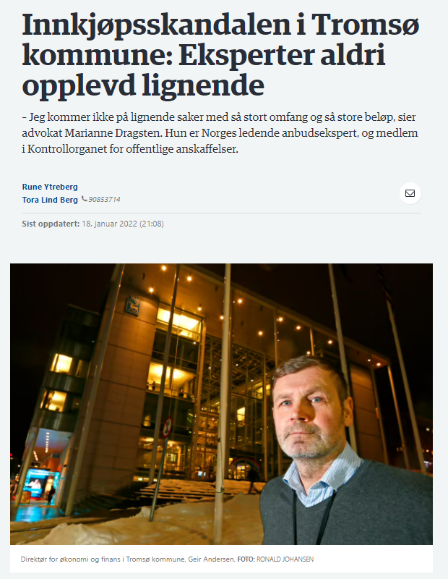
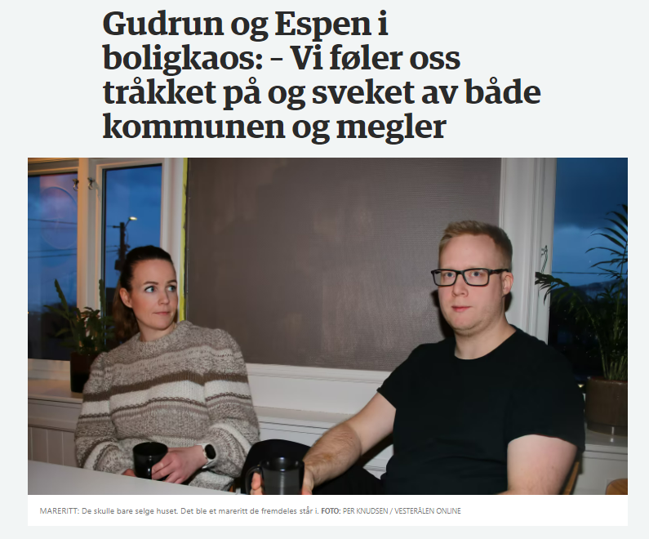
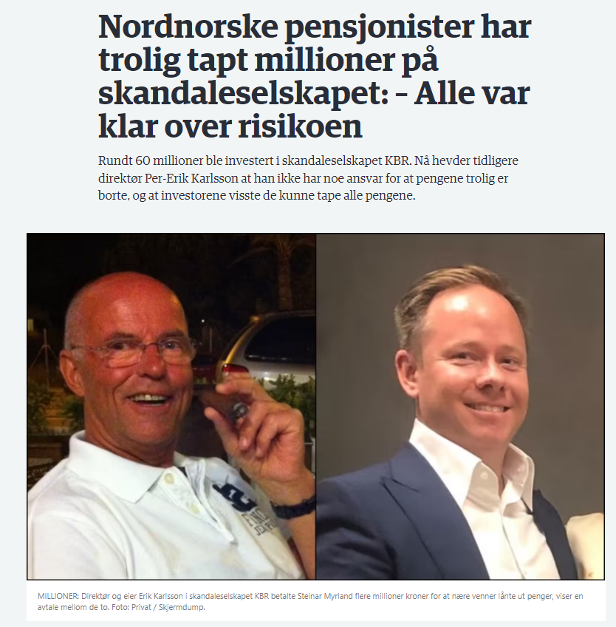
A few interesting projects from the past year

Slide 7
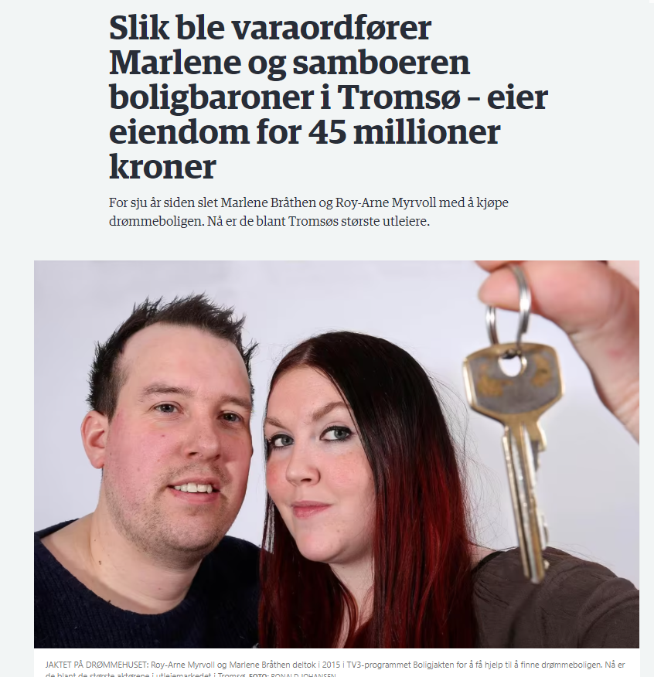
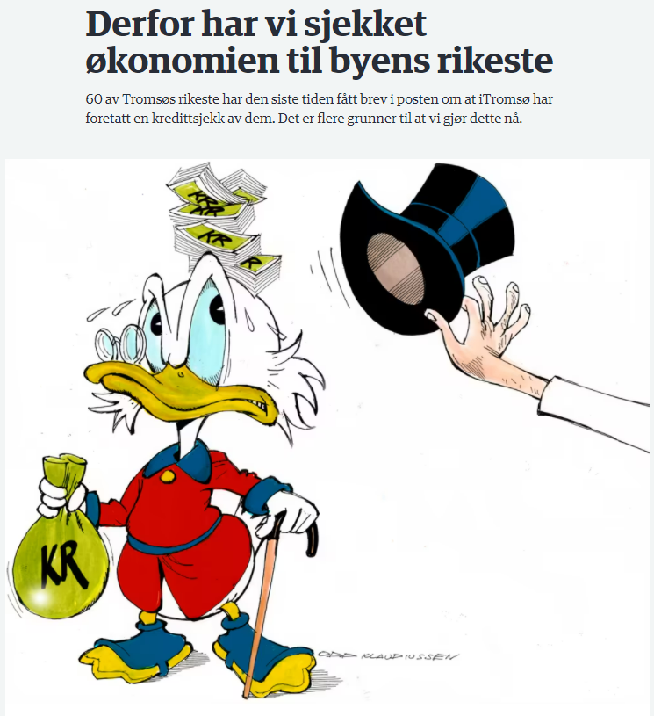

Slide 8
The vice mayor’s wild real estate adventure
Housing market is a gold mine for journalists
Cooperation with SUJO
We spent several weeks on the story – mostly working with documents
Multiple stories spanning from december until now
Klikk for å legge til tekst

Slide 9
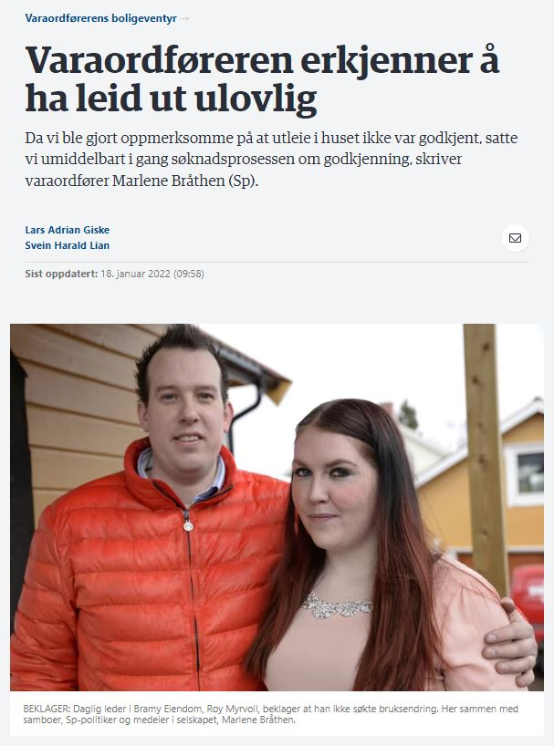

Slide 10
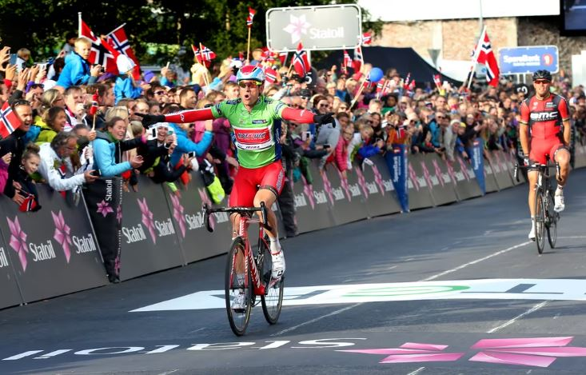
Arctic Race: Following the money
Cooperation between the news desk and the sports desk
We shared all our documentation with other newspapers in Polaris Media
Revealed the hidden cost for local municipalities to be millions of kroner

Slide 11
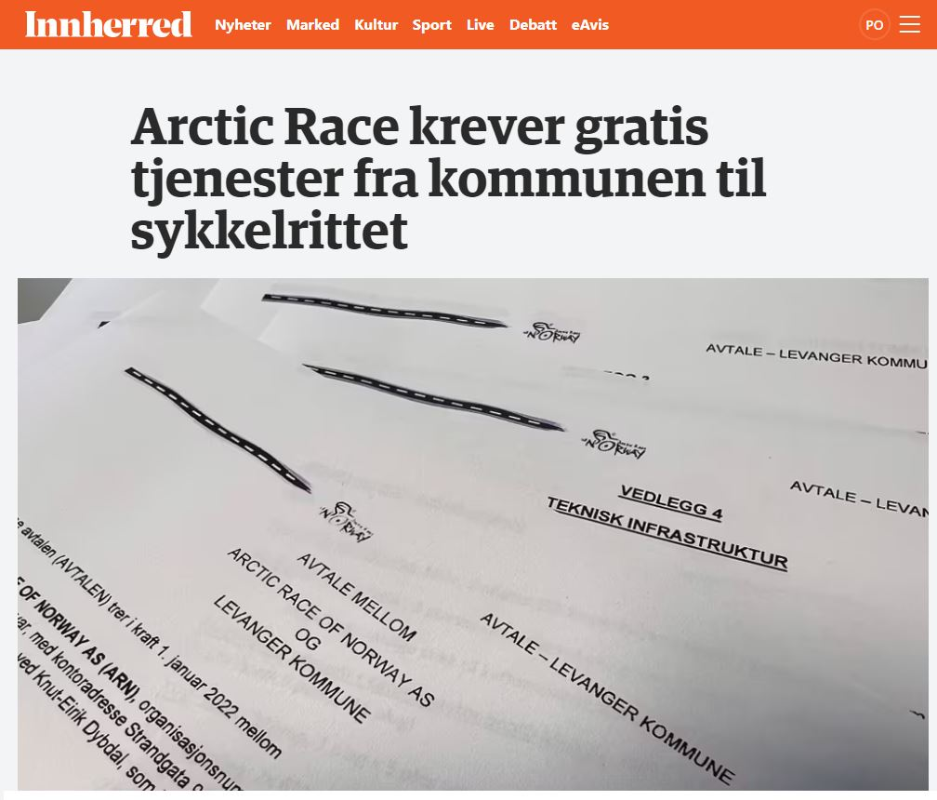

Slide 12
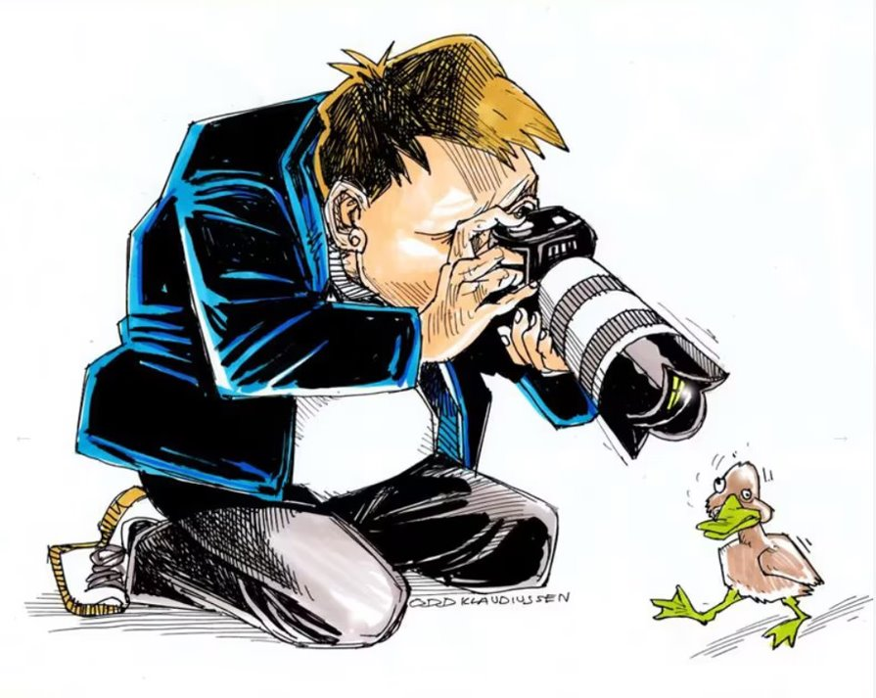
Simple tricks to bring home
Prioritize – yes it hurts
Involve everyone
Use your newsroom’s competance
«Half days»
Find the winner projects
Publish and more sources will appear

Slide 13
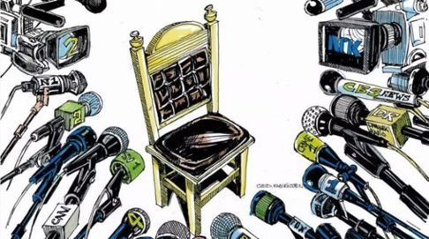
Priorit
Prioritize
Om ikke prioriteringene svir – har du heller ikke prioritert
Definer de viktigste sakene hver dag
Du kan gå på en smell. Av og til får konkurrenten gull, mens du står igjen med gråstein.
Lager vi færre saker per journalist
… men vi lager bedre og mer gjennomarbeidede saker
If it doesn’t hurt – you haven’t done it right
Define clearly what the most important stories are every day
You will miss out. Sometimes you make the wrong decision, while your competition gets it right.
Fewer articles per journalist
… but better and more hard hitting stories
Klikk for å legge til tekst
Klikk for å legge til tekst

Slide 14
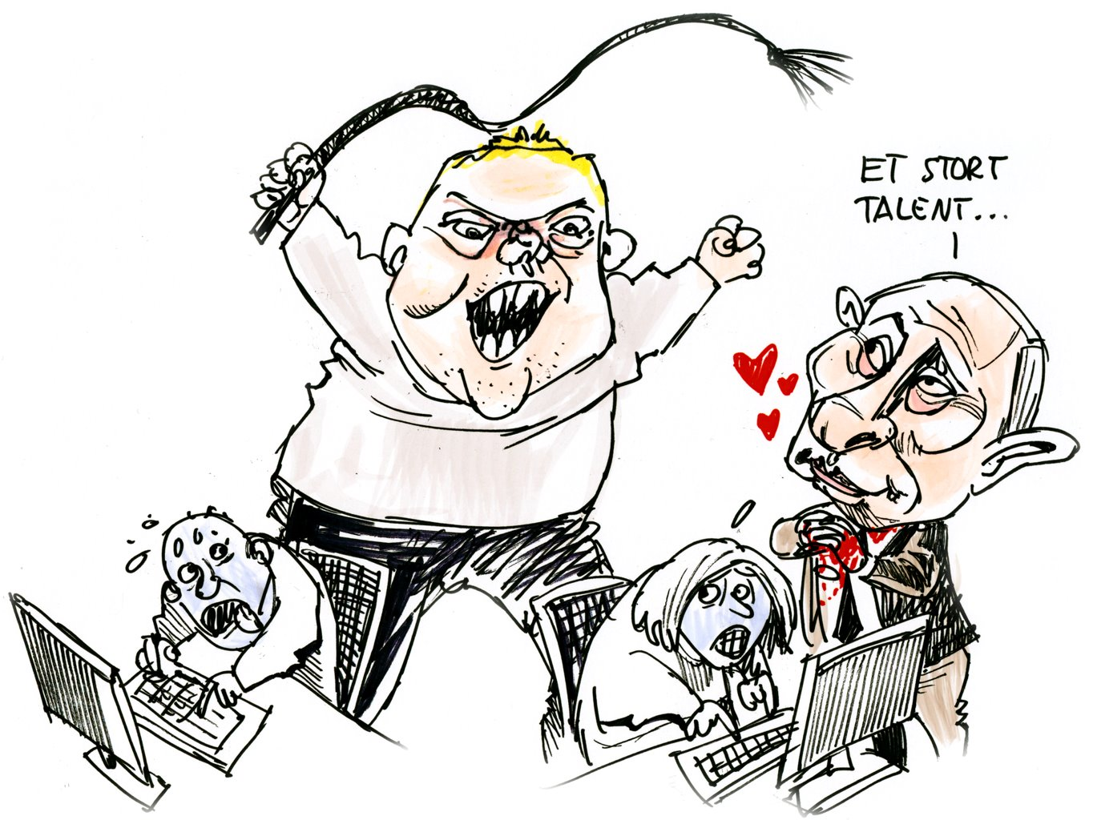
Involve
Use your coworkers
Projects are unlikely to succeed unless multiple people want it to.
Shared to do-list
Shared documents
Brainstorming
Keep your editor updated

Slide 15
Why?
Everyone else has to work harder when you work on a major project
Everyone gets to do it – as long as the idea is good enough
So for the love og god: Keep your coworkers involved

Slide 16
Keep track of your projects

Slide 17
Finding the good projects
Documents are goldmines
Be specific
Bet on winning horses: Find sectors and themes where you will dig up multiple good stories.

Slide 18
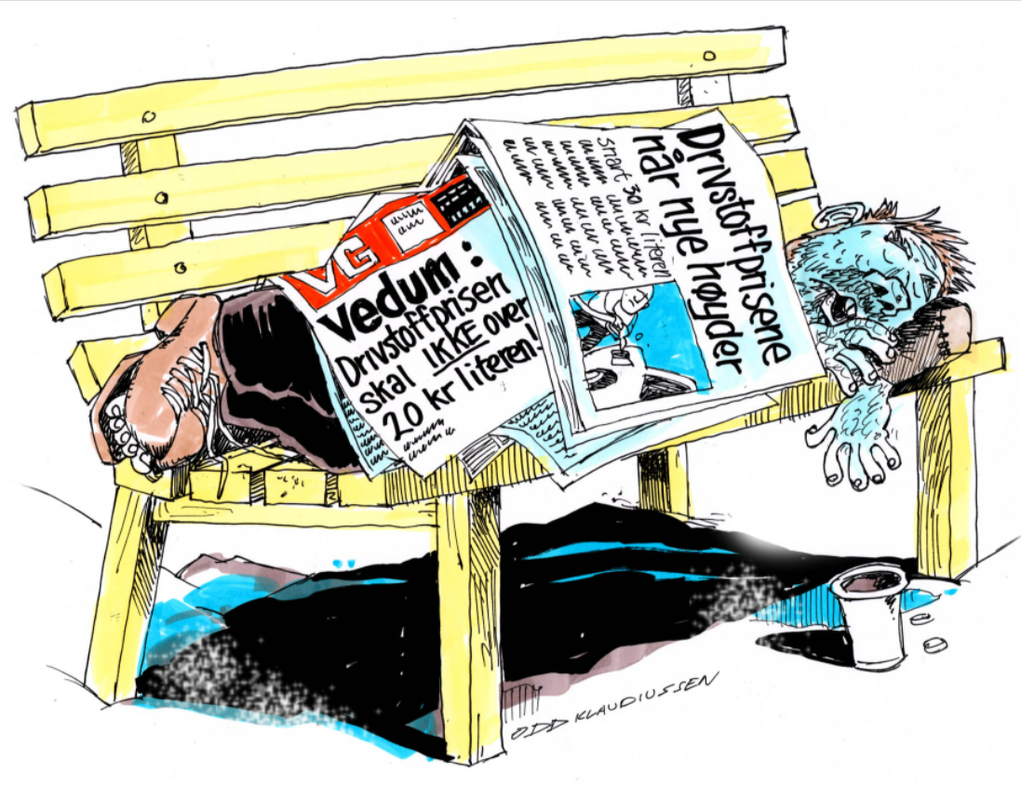
Thank you
«At det finnes en aksept for å leke seg i en avis – det tror jeg er satans viktig»

